Slide 1


IE2091
Information Systems Project
Lecture 02
Agile Project Plan Preparation
Mrs. Narmada Gamage
Faculty of Computing

Slide 2
Session Objectives
By the end of this session, students will be able to:
Develop a Product Vision Statement
Create an initial Product Backlog using Epics and User Stories
Define a suitable Definition of Done (DoD)
Prepare Agile-based project planning artifacts for Sprint 0

Slide 3
SCRUM
“An agile framework that allows us to focus on delivering the highest business value in the shortest time” -Mike Cohn
  The fastest growing approach to software development
  Used by many fortune 100 companies
  Google, Microsoft, Sun, IBM, Nokia, HP, Infosys

Slide 4
SCRUM Framework

Slide 5
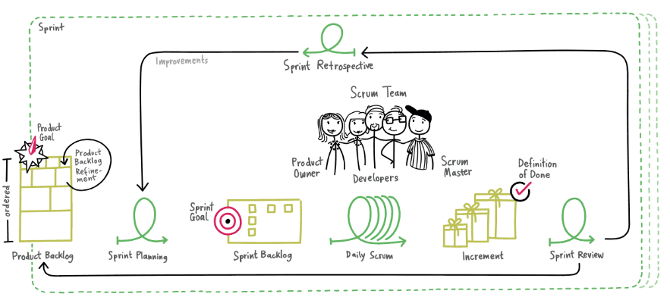
SCRUM Framework

Slide 6
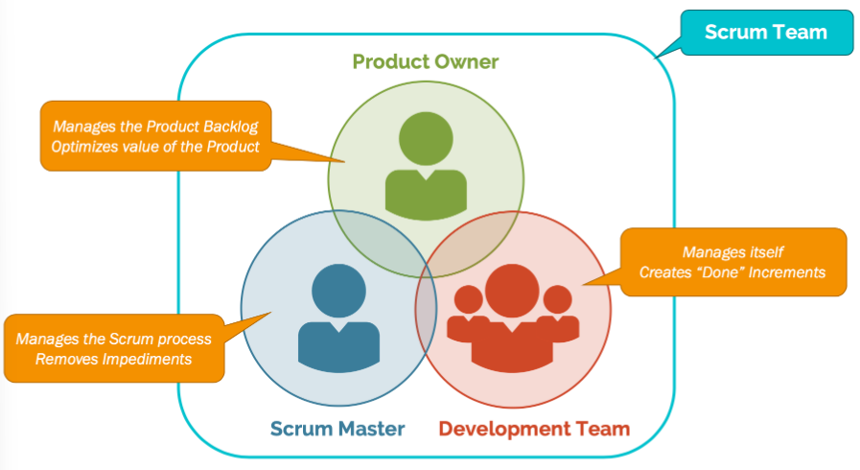
Roles
Product owner
Scrum master
Team

Slide 7
Product Owner
1 person
Owns vision for what should be produced (Sets the direction)
Define the features that need to be included in the product backlog
Prioritize product features and adjust them in every iteration
Accept or reject the work/results

Slide 8
Scrum Master
1 person- Servant leader
Ensures that the project is progressing smoothly
Ensures that the team members are equipped with all the tools required
Protects the team from disturbances and keep them focused on the tasks
Coaches the team and product owner to be successful with Scrum
Is knowledgeable, questions, patient, transparent, care for the team

Slide 9
Scrum Team
7 people, +/-2 (Right size)
Cross functional individuals (Design, Code, Test, etc.)
Self organizing and self managing
Should be full time workers
Inspect and adapt through daily scrum and retrospective
Develops T shaped skills

Slide 10
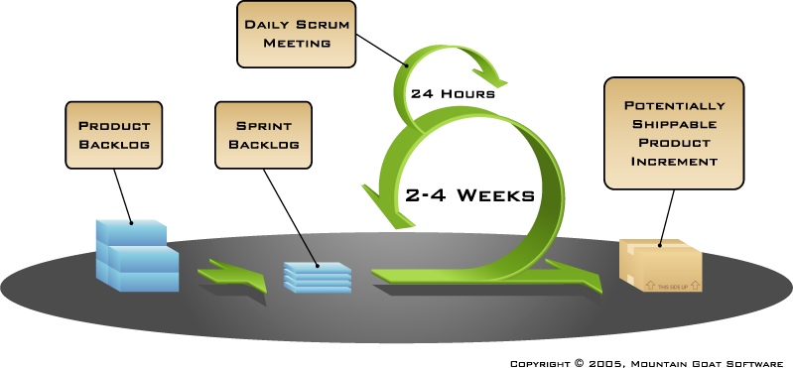
Artifacts
Product backlog
Sprint backlog
Burndown charts

Slide 11
Sprint
Scrum projects make progress in a series of “Sprints”
Usually takes 2-3 weeks
A product is designed, coded and tested during a sprint
The outcome is a potentially shippable product
Sprints are repeated until the product is developed fully with all features

Slide 12
Product Backlog
Created by product owner
Includes functional and non functional requirements
Is like a wish list of all the things the product owner wants in the product
Presented as USER STORIES
Prioritize the list
The list created during Sprint 0, evolves and is reprioritized at the start of each sprint

Slide 13
Product Backlog
Commitment : Product goal
  Describes future state of the product which serves as a target of the Scrum team to plan against
  Act as long-term objective for the Scrum team which they can full fill (or abandon)
  User stories in the product backlog defines “What” will fulfill the Product Goal

Slide 14

User Stories
As a (role) I want (feature) so that (benefit).
A way of describing a feature set
Written from the perspective of the end user
Gives the right amount of details for estimation
As a customer, I want to track my order so that I know delivery status

Slide 15
Sprint Backlog
Created by the scrum team
Includes the list of user stories that need be completed in a given sprint
Should not have more than 300 tasks in the list
If a task requires more than 16 hours, it should be broken down
Revised daily

Slide 16
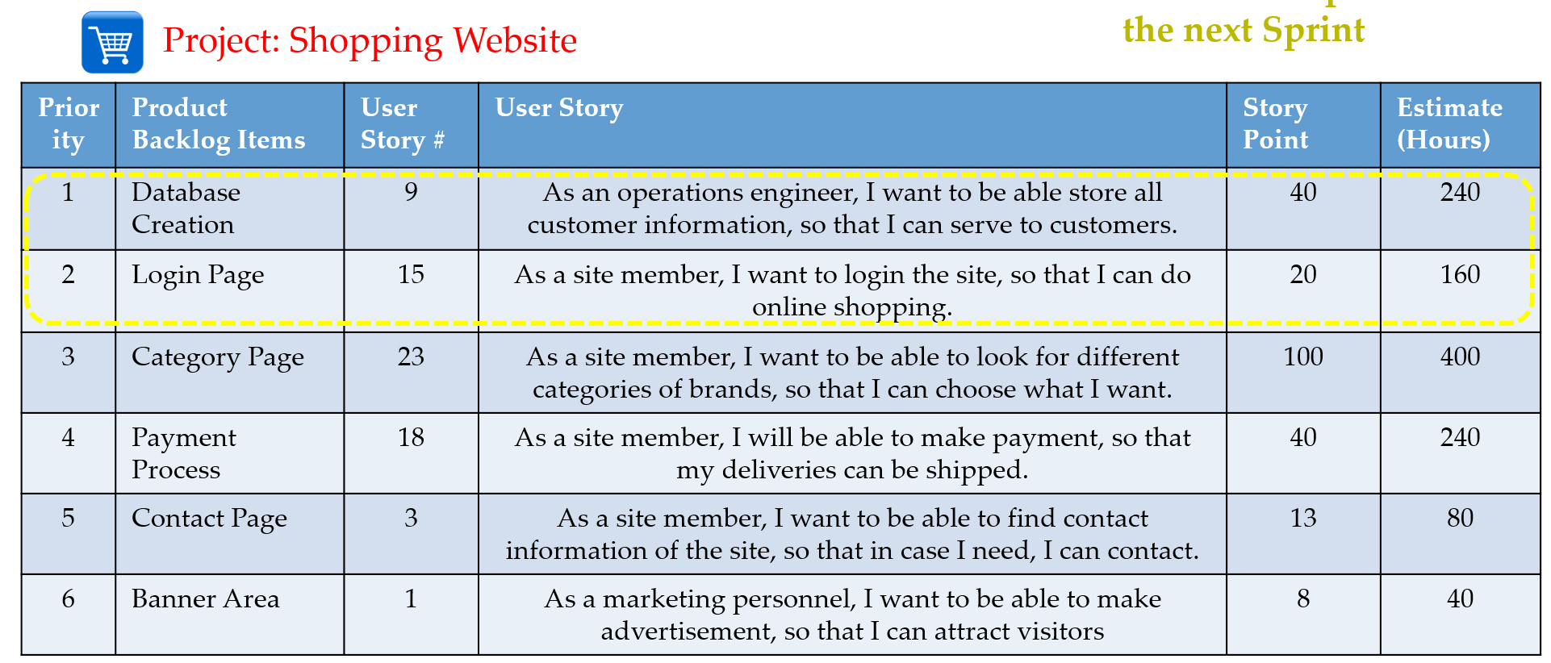
Product Backlog

Slide 17
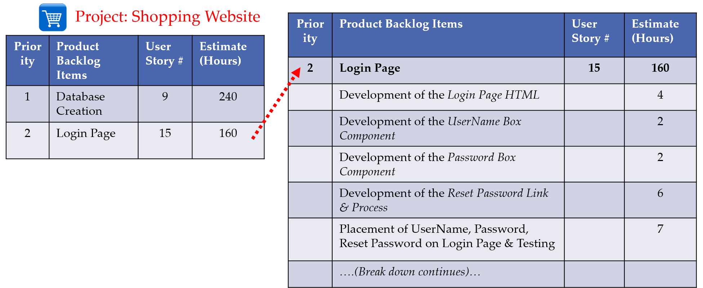
Sprint Backlog

Slide 18
Sprint Backlog
Commitment : Sprint goal
  Single objective for the Sprint which describes commitment required by the developers
  Provides coherence and focus, encouraging the Scrum team to works together.
  Created during the Sprint planning event and added to the Sprint Backlog.

Slide 19
Burndown Chart
Used to monitor the progress of each sprint
Shows how much work is remaining daily
Shows the estimated amount of time to release
Should burn down to zero at the end of the sprint
Best project visibility tools

Slide 20
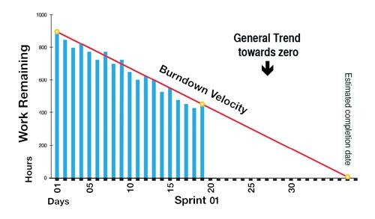
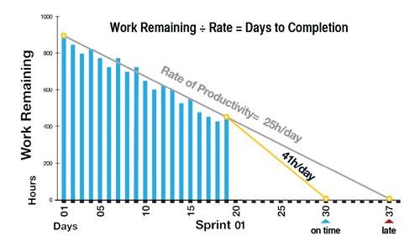
Burndown Chart

Slide 21
Increment
Concrete steppingstone towards the product goal
Each increment is additive to all prior increment and thoroughly verified, ensuring that all increments work together
Usable / workable multiple increments may created within a Sprint
Work should meets the Definition of Done to be considered as an Increment

Slide 22
Increment
Commitment : Definition of Done (DoD)
  State of the increment when it meets the quality measures required for the product
  When Product backlog item meets DoD, an Increment is born
  If a Product Backlog item does not meet the DoD, it cannot be released or presented at the sprint review

Slide 23


Sprint Planning
How do we do it?
Daily Scrum
How are we doing?
Sprint Review
How did we do it?
Sprint Retrospective
How do we do better?
Ceremonies
Sprint planning
Daily scrum
Sprint review
Sprint retrospective

Slide 24
Sprint Planning
Determine how much work can be accomplished in the upcoming sprint and answer “How do we do it”
Create the product backlog
Determine the sprint goal
Participants- Product owner, scrum master, scrum team
Output- Create sprint backlog

Slide 25
Daily Scrum
A brief standup meeting held daily with the scrum master and team
Enables to share progress and for scrum master to track progress
15 minutes maximum
Stands in a circle and reports 3 things
  What did I do since the last scrum meeting?
  What will I try to do by the next scrum meeting?
  What are the obstacles faced?
Listen. Do not debate.

Slide 26
Sprint Review
Team demonstrates the work completed during the sprint
Takes the form of a demo of new features
Informal meeting
Product owner approve or reject the work
Product owner gives the feedback for completed work

Slide 27
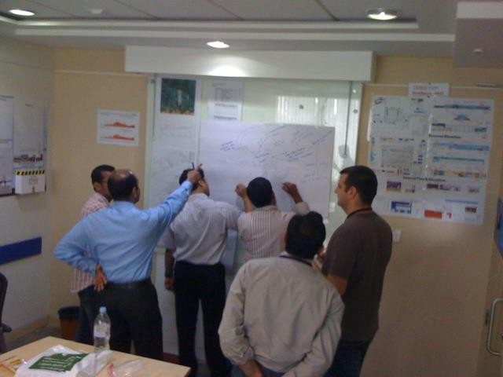
Sprint Retrospective
Discuss what went well and what could be better for improvements
What should be continued, started or stopped.
15-30 minutes
Done after every sprint
Use whiteboards, sticky notes, flipcharts

Slide 28
Agile Project planning

Slide 29
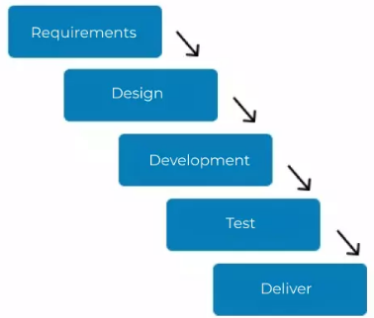
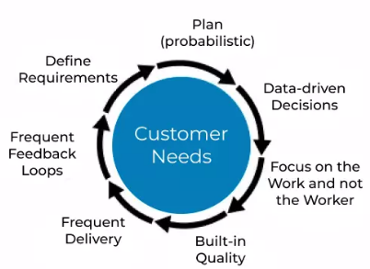
Traditional Vs. Agile Planning
Agile planning is iterative, not one-time
Planning starts with:
  Problem Identification
  Product Vision
  Product Backlog
Planning continues through:
  Sprint Planning
  Reviews & Retrospectives

Slide 30

Let’s apply the Scrum basics learned above to prepare for Sprint 0

Slide 31

What Sprint 0 should achieve
Sprint 0 is a preparation sprint to start Sprint 1 successfully
No production code delivery
Focuses on:
  Problem
  Vision
  Backlog
  DoD
  Planning

Slide 32

Sprint 0 objectives
By the end of Sprint 0, the team should have:
  Identified the real user problem
  A clear Product Vision
  Identified stakeholders
  Initial Product Backlog
  Epics & user stories
  Defined Definition of Done
  High-level sprint plan

Slide 33

Sprint 0 Deliverable : Problem Identification
Clearly defines the real-world problem
Focuses on:
  Who is affected?
  What pain exists?
  Why it matters?
  Forms the foundation for vision and backlog
  Avoids solutions
  Template : Currently, [user] struggles with [problem], resulting in [impact].

Slide 34

Sprint 0 Deliverable : Product Vision Statement
  Describes the purpose and value of the product
  Aligns stakeholders around a common goal
  Guides backlog creation and prioritization
  Describes:
    Who the product is for
    What problem it solves
    Why it is valuable
  Template : For [target users] Who [have a problem] The product [name] Provides [key benefit]

Slide 35

Sprint 0 Deliverables : Stakeholders
  Identifies individuals or groups affected by the system
  Primary stakeholders directly use the system
  Secondary stakeholders support or influence usage
  Ensures requirements reflect real needs

Slide 36

Sprint 0 Deliverables : Epics & User Stories
  Epics represent large functional goals
  User stories break Epics into manageable pieces
  User stories drive Sprint Planning
  User Story Template: As a [user], I want [feature], so that [benefit]

Slide 37
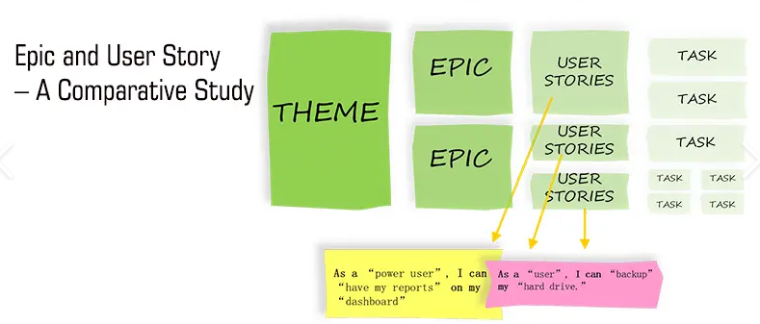
Sprint 0 Deliverables : Epics & User Stories

Slide 38
Sprint 0 Deliverables : Initial Product Backlog
  Ordered list of features and requirements
  Contains Epics, User Stories, and constraints
  Created collaboratively with Product Owner
  Backlog evolves throughout the project

Slide 39
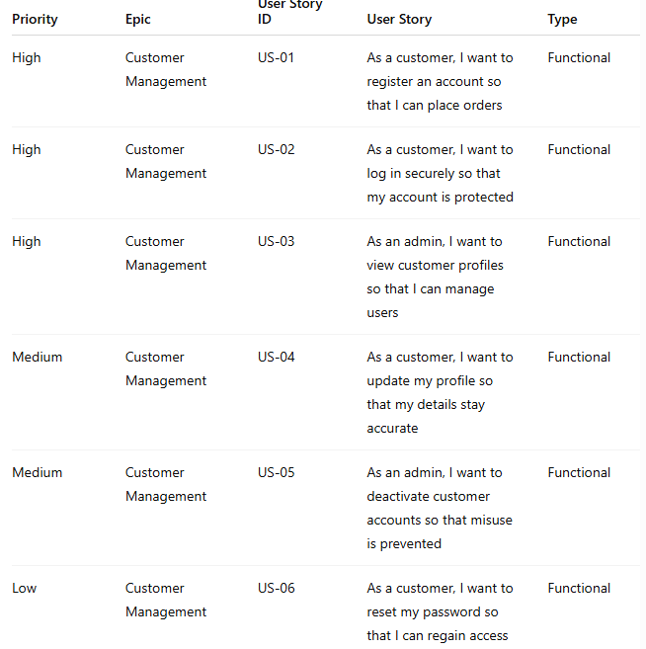

Sprint 0 Deliverables :
Initial Product Backlog
  Example : Customer management Epic

Slide 40

Sprint 0 Deliverables : Definition of Done (DoD)
  Shared agreement on when work is considered complete
  Ensures quality and consistency
  Applies to all user stories and increments

Slide 41
Sprint 0 Deliverables : Definition of Done (DoD)
The Customer Management Epic is considered Done when all related user stories meet the following criteria:
✔ Functional Completion
  Customer can be created, viewed, updated, and deactivated
  Mandatory fields are validated (e.g., name, email)
  Duplicate customer entries are prevented
✔ Quality & Testing
  All user stories are implemented and tested
  No critical or high-severity defects remain
  Basic edge cases are handled (empty fields, invalid inputs)
✔ Integration
  Customer data is stored and retrieved correctly
  Changes reflect correctly across the system
  No broken links or navigation issues
✔ Documentation
  User stories are updated with acceptance criteria
  Basic user guide or help notes are completed
✔ Demo & Acceptance
  Functionality is successfully demonstrated
  Accepted by the Product Owner
  Meets the agreed Definition of Done checklist

Slide 42
References
https://scrumguides.org/docs/scrumguide/v2020/2020-Scrum-Guide-US.pdf#zoom=100
Agile Estimating and Planning (Robert C. Martin Series) 1st Edition

